Slide 1
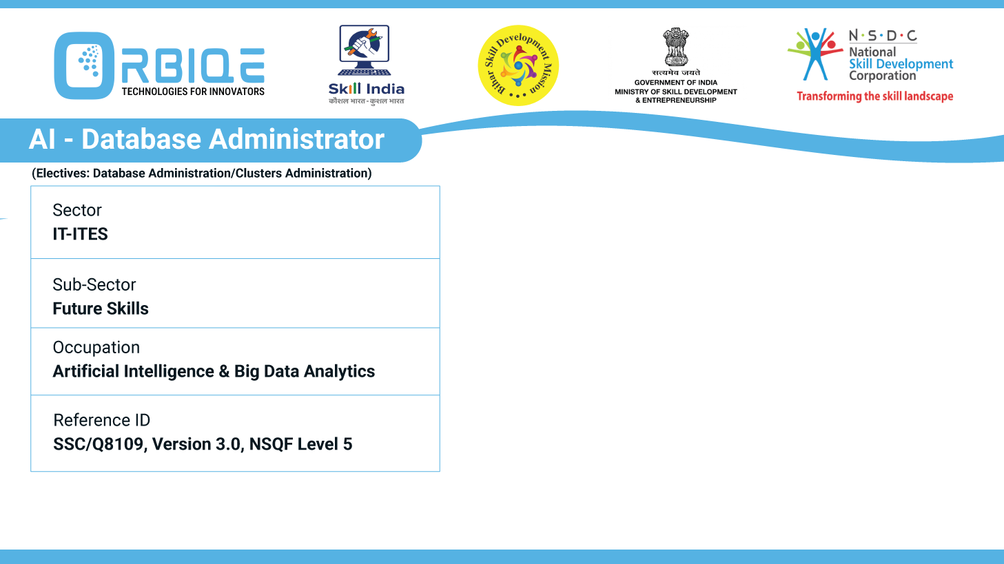
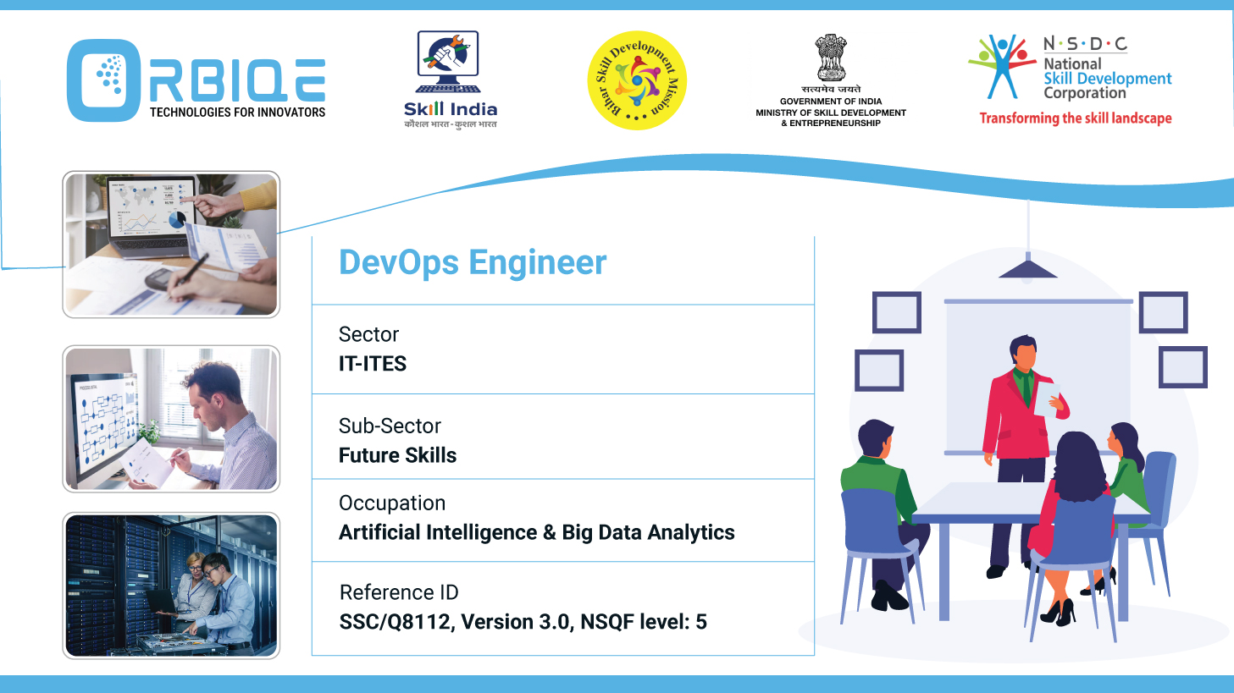
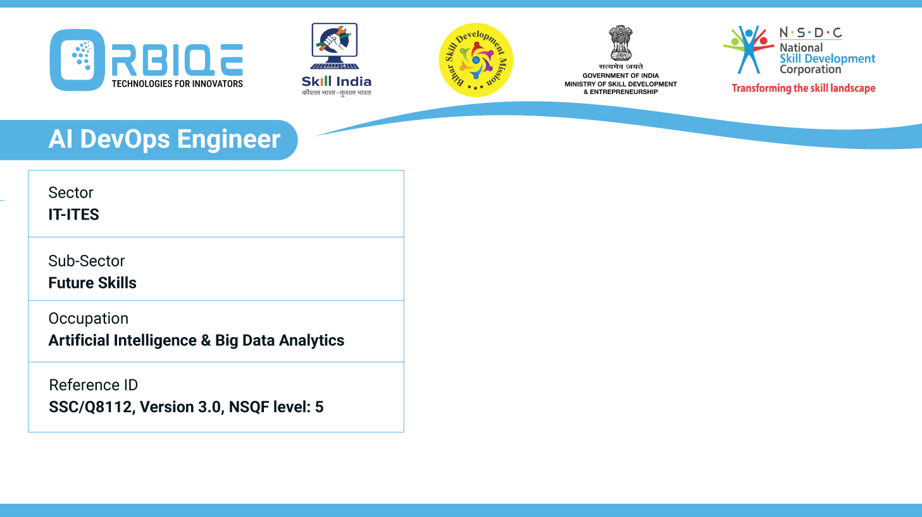
Name- Krishna Kant Dubey

Slide 2

Selecting the Right Database Tool: SQL and NoSQL Strategies

Slide 3
Agenda
Data Structure
Scalability Needs
Consistency vs. Availability
Query Complexity
Schema Flexibility

Slide 4
Data Structure
SQL: Best for structured data with predefined schemas
(e.g., financial records, inventory systems).
NoSQL: Ideal for semi-structured or unstructured data
(e.g., social media posts, IoT logs).

Slide 5
Scalability Needs
SQL: Vertical scaling (adding more power to a single server)
NoSQL: Horizontal scaling (adding more servers), suitable for large-scale distributed systems.

Slide 6
Consistency vs. Availability
SQL: Strong consistency via ACID properties
—great for banking or transactional systems
NoSQL: Eventual consistency via BASE model
—better for real-time analytics or content delivery networks

Slide 7
Query Complexity
SQL: Supports complex joins, aggregations, and analytics
NoSQL: Optimized for simple queries and fast reads/writes, but limited in relational operations

Slide 8
Schema Flexibility
SQL: Requires a fixed schema
—ideal for applications with stable data models
NoSQL: Schema-less
—perfect for evolving applications or rapid prototyping

Slide 9
Thank You

